Slide 1
Federal Aviation Administration
License Renewal Forecasting
DSA 5900
Haixiao Lu
Sponsor: OU DISC
Advisor: Professor Beattie, Dr.Nicholson, Dr.Reinert

Slide 2
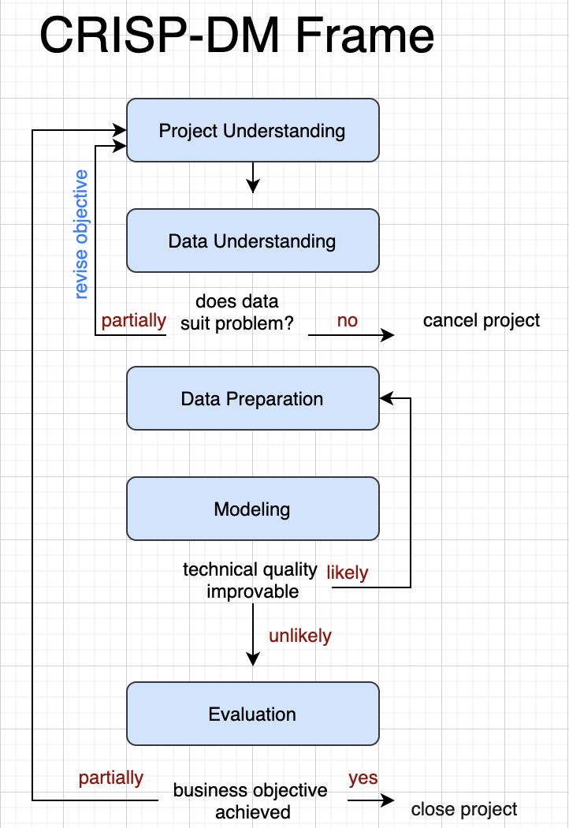
Presentation Outline
Project Scope
Data Exploratory Analysis
Modeling & Evaluation
Conclusion

Slide 3
Part One
Project Scope

Slide 4
Background
Pilots must take an Aeromedical Examination to be allowed to operate an aircraft
FAA Interested ( Dr. Anthony Tvaryanas)
“The Age of Big Data” period
Using current machine learning methods to improve future forecasting
Determine if an airman will be flight ready
The likelihood of a significant state change during the current certification period
To identify and exclude unacceptably increase risk during the relevant period of certification after the examination
According to ICAO (International Civil Aviation Organization))
pilots will not exercise the privileges of their license
If they are aware any medical condition
Notes:
Why Aeromedical Examination is important?
To identify...

Slide 5
Objective
Big Picture:
Given an individual’s health history from the past 1/3/5 years, what is the likelihood of them transitioning from their current health state to an unhealthy state in the next 3 years

Slide 6
Objective
Start Small, Scale up
Demonstrate an approach based on one diagnosis category (circulatory system) to perform safety-critical tasks in an unacceptable risk
Based on the medical history of airman applicants with and without circulatory system diagnosed in 2019, forecasting the likelihood of whether these applicants diagnosed with circulatory system or not in 2020
Notes:
What is safety-critical means?

Slide 7
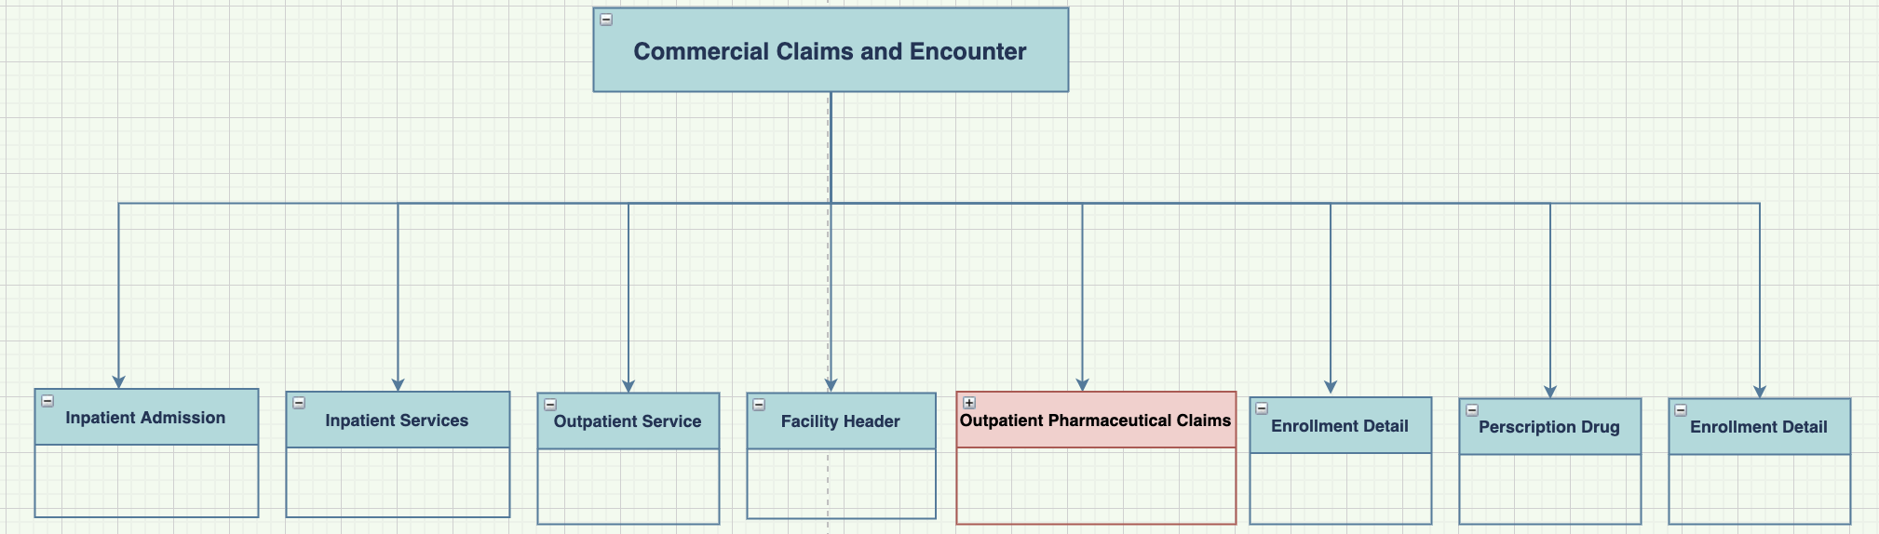
Data
IBM MarketScan Commercial Claims and Encounters
Inpatient Admission Table
Inpatient Services
Outpatient Services Table
Facility Header Table
Outpatient Pharmaceutical Claims
Annual Enrollment Summary Table
Enrollment Detail Table
Outpatient Prescription Drug

Slide 8
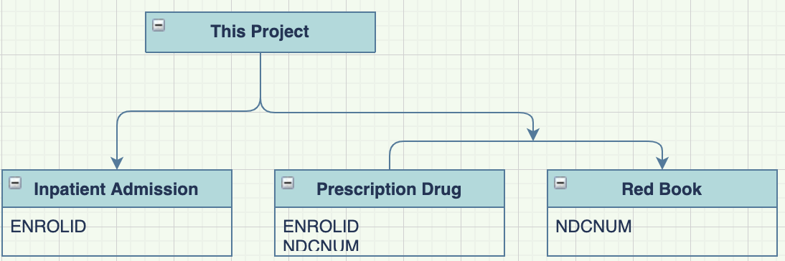
Data
IBM MarketScan Commercial Claims and Encounters
Inpatient Admission Table
Inpatient Services
Outpatient Services Table
Facility Header Table
Outpatient Pharmaceutical Claims
Annual Enrollment Summary Table
Enrollment Detail Table
Outpatient Prescription Drug
Notes:
A lots of data, we only focus most relevant data in this project

Slide 9
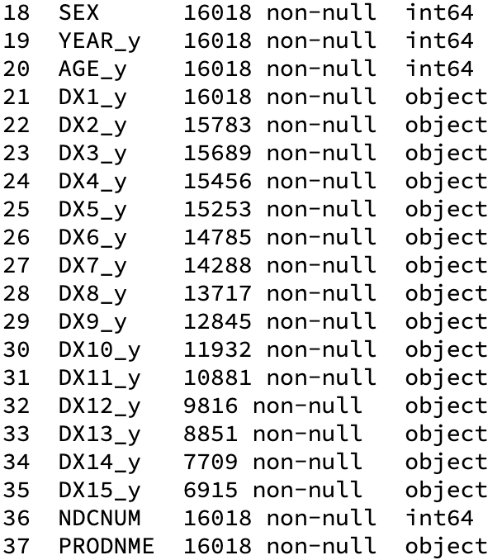
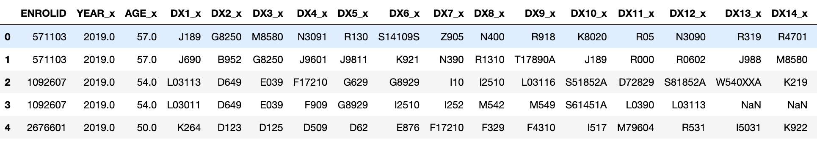
Data Information
38 features
Enrolid, Age, Sex, Diagnosis codes, Year, Ndcnum, Prodnme

Slide 10
Part Two
Exploratory Data Analysis

Slide 11
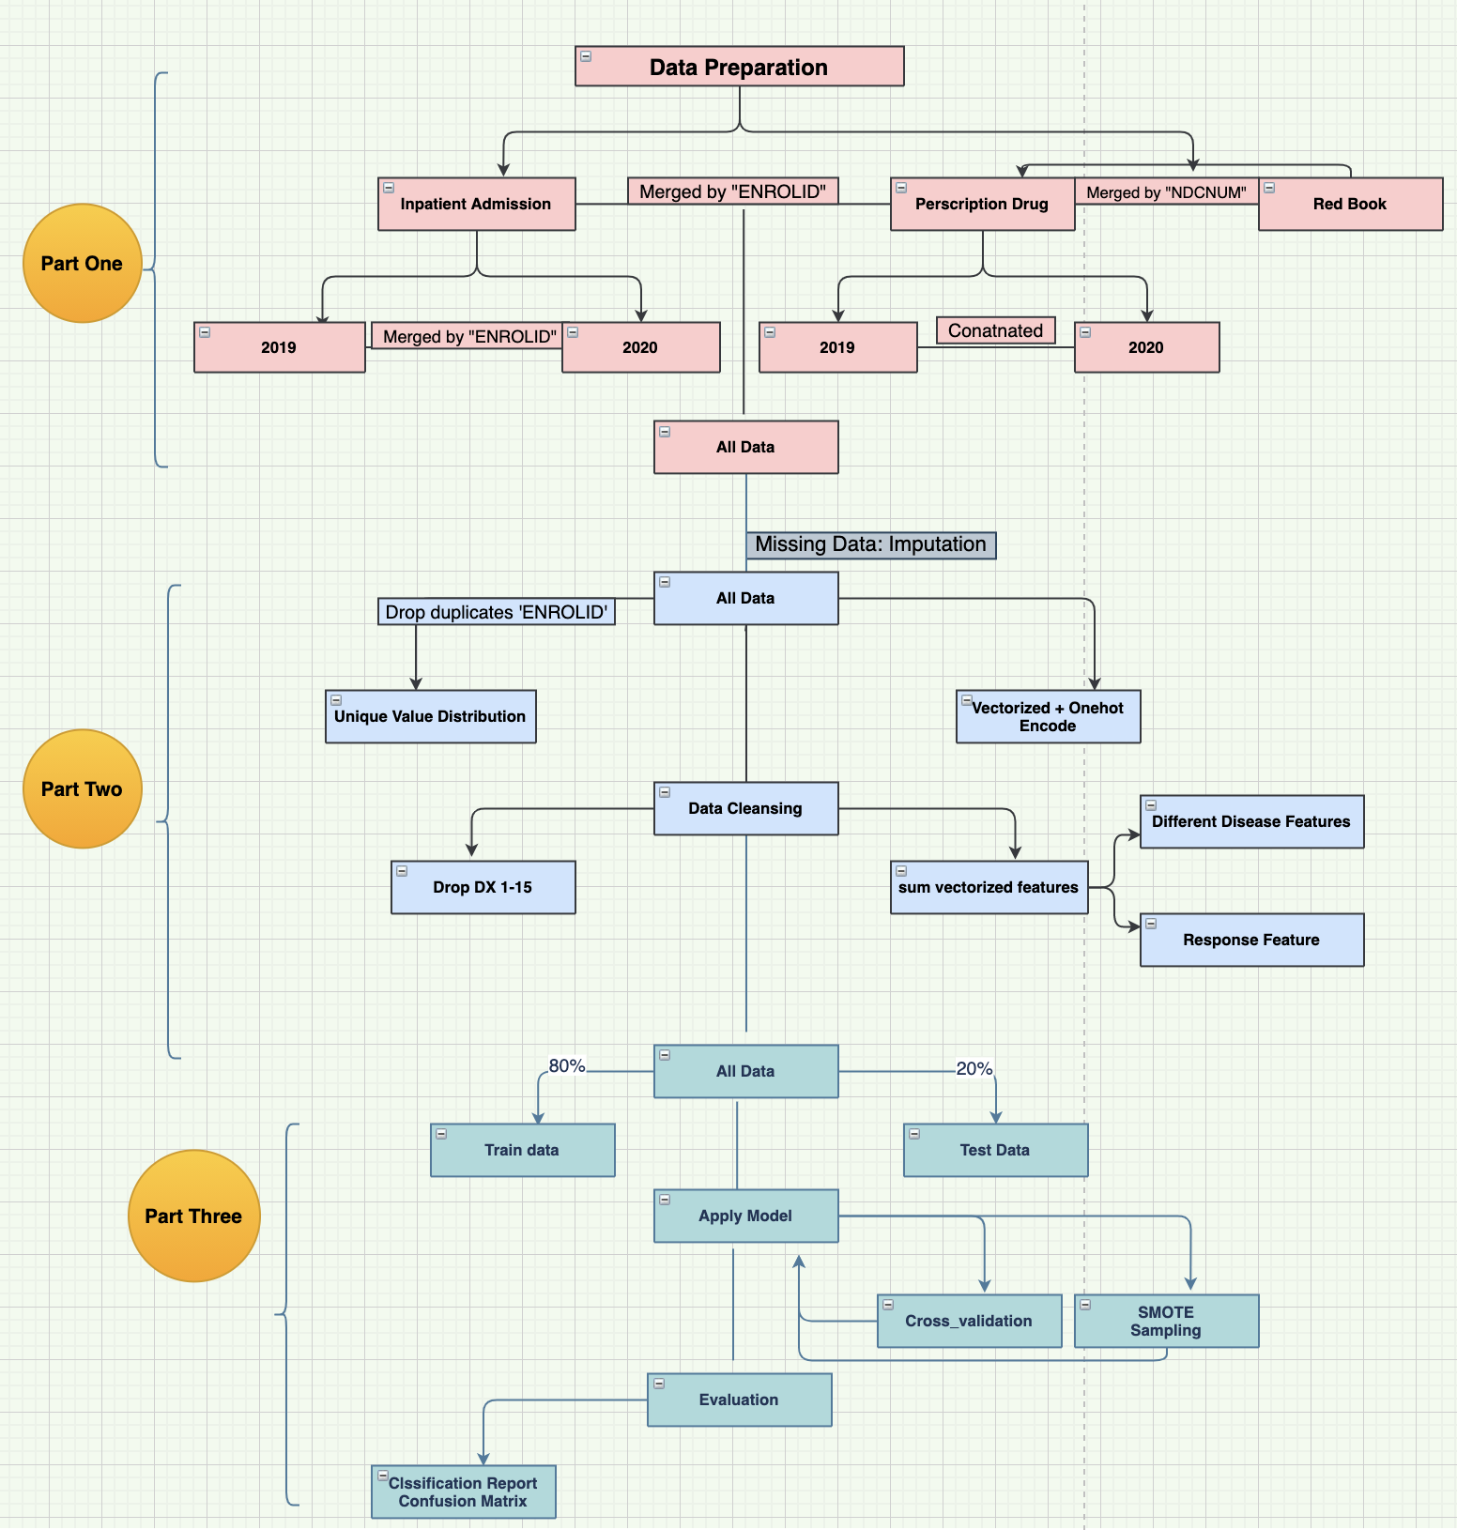
Data Preparation

Slide 12
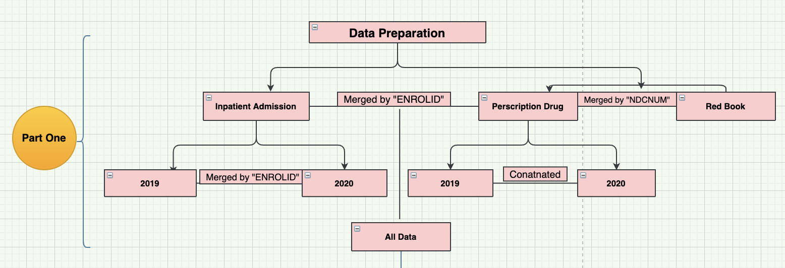
Data Preparation
Inpatient Admission
Prescription Drug
Red Book

Slide 13
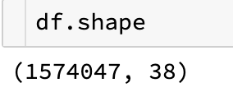
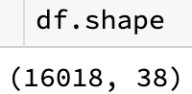
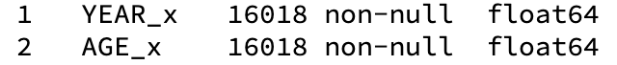
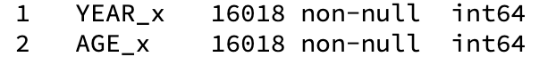
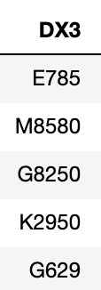
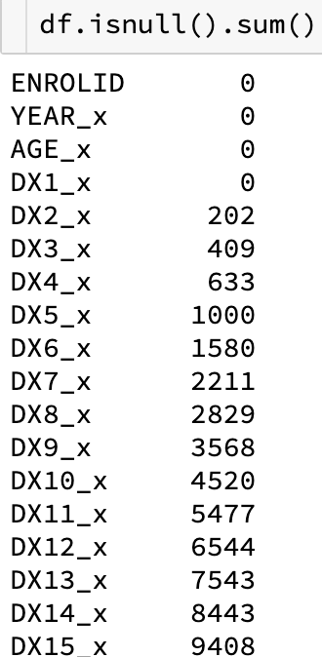
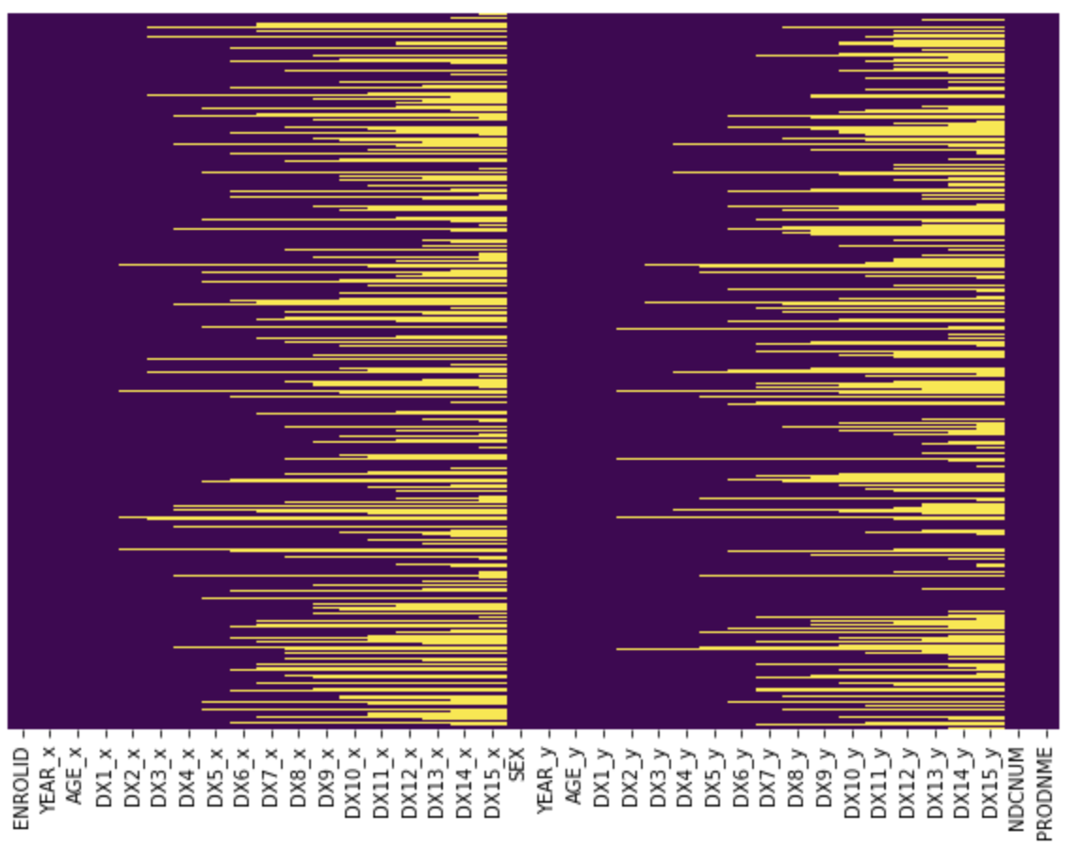
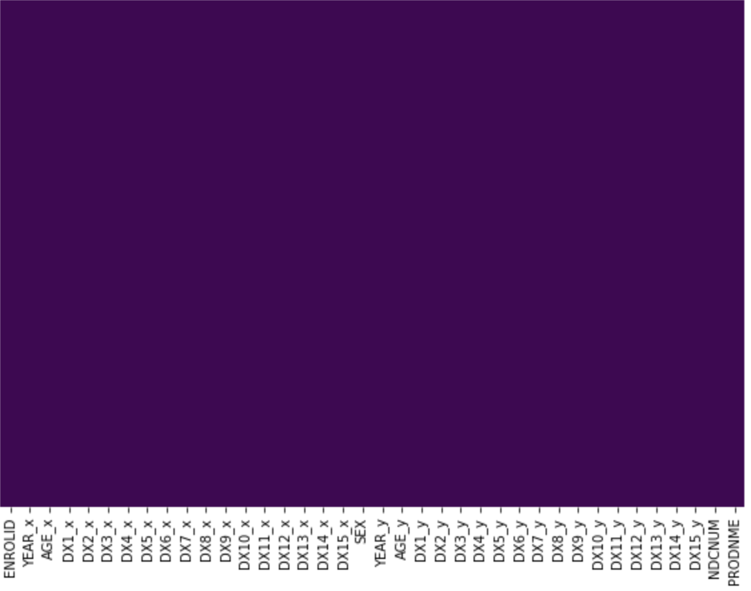
Data Preparation
Duplicates
ENROLID, NDCNUM
Convert data type
Missing Values
Before
After

Slide 14
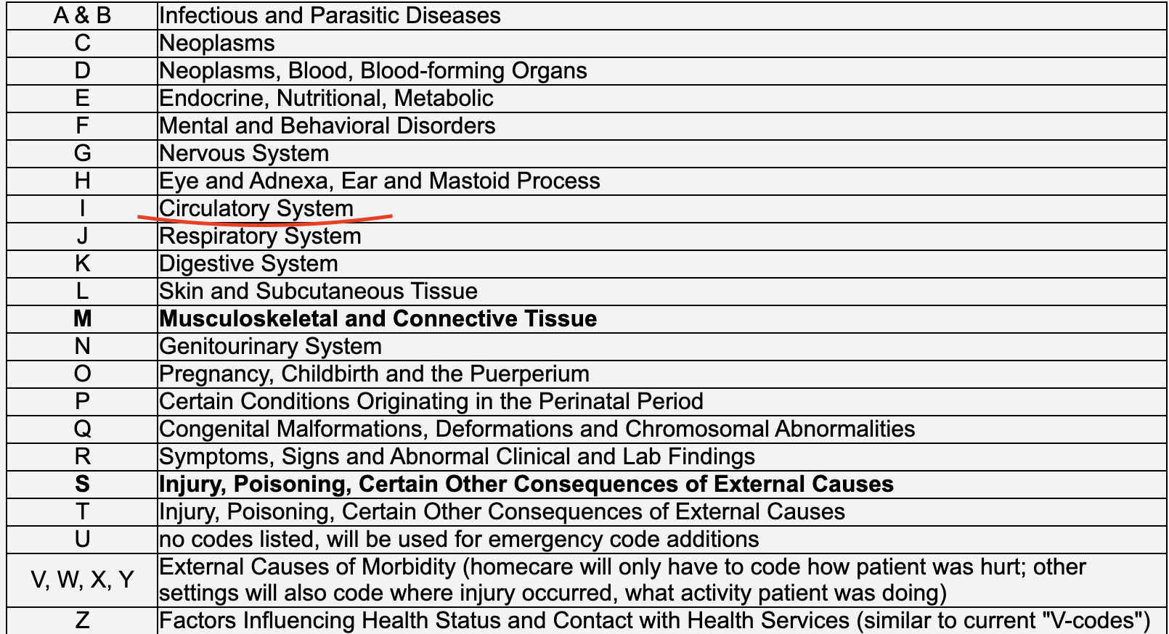
Data Exploratory
Diagnosis Code
ICD-10-CM (International Classification Diseases)
ICD Code Structure
Character 1-3
Indicate the category of the diagnosis
Character 4 - 6
Indicate anatomic site, severity or other clinical detail
Character 7
Extension

Slide 15
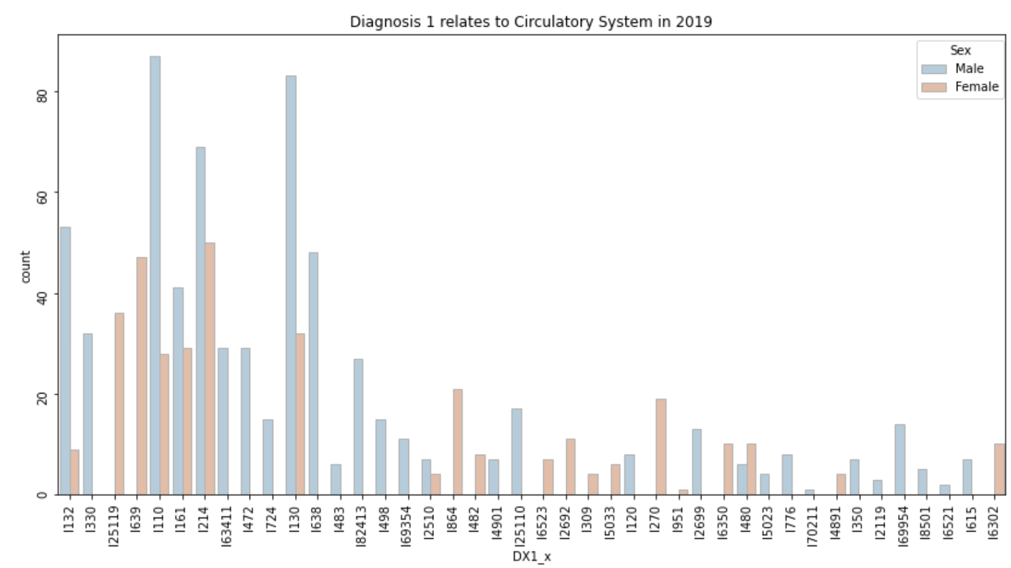
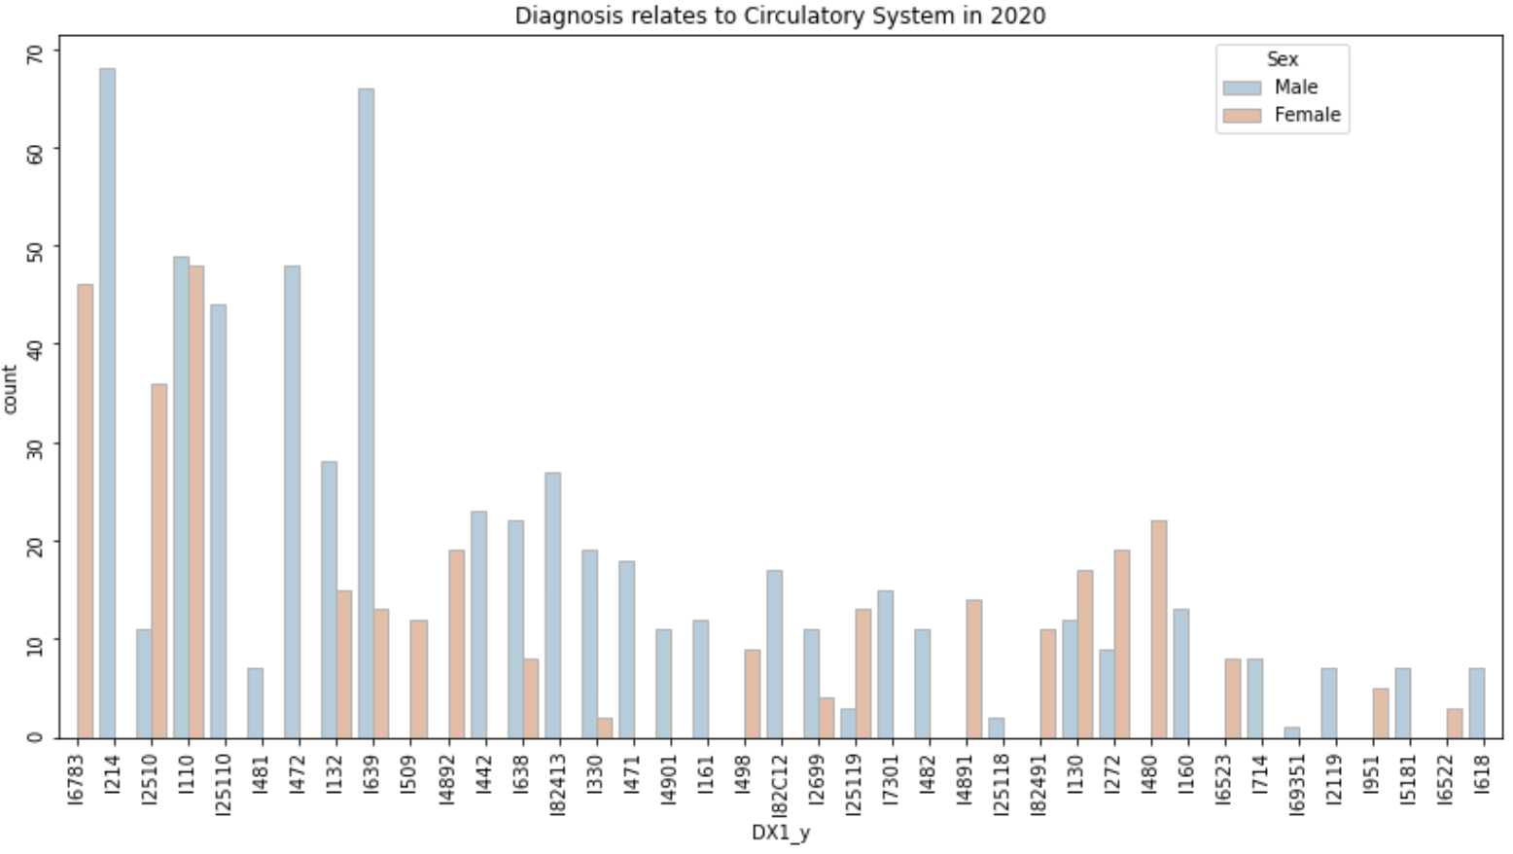
Data Exploratory
Circulatory System (I) Diagnosis Code
2020
2019

Slide 16
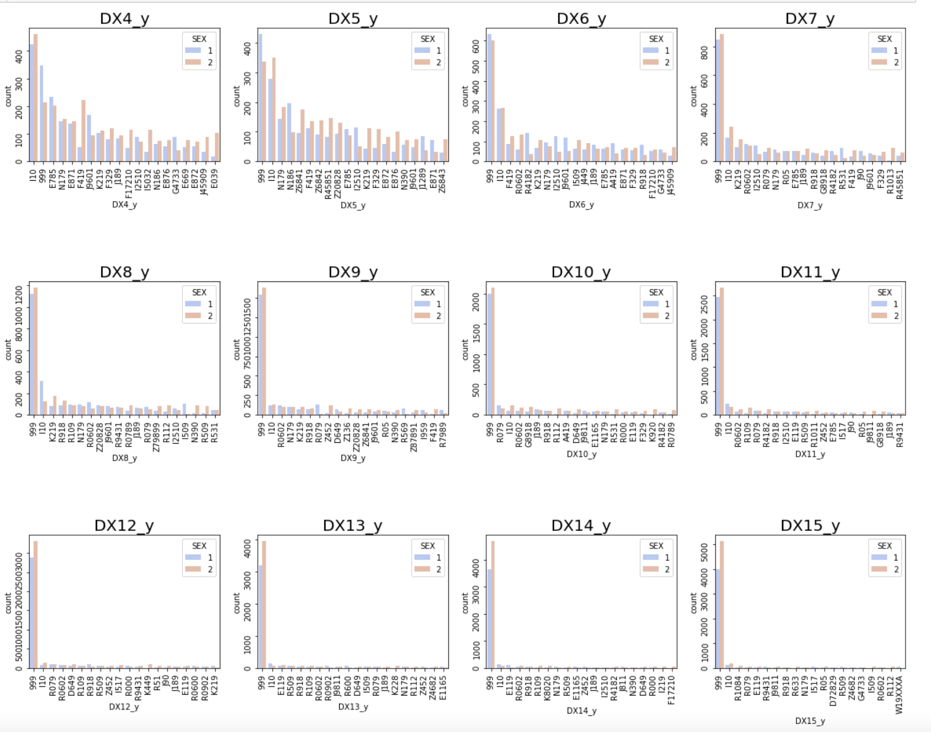
Data Exploratory
Other Diagnosis Codes
High blood Pressure

Slide 17
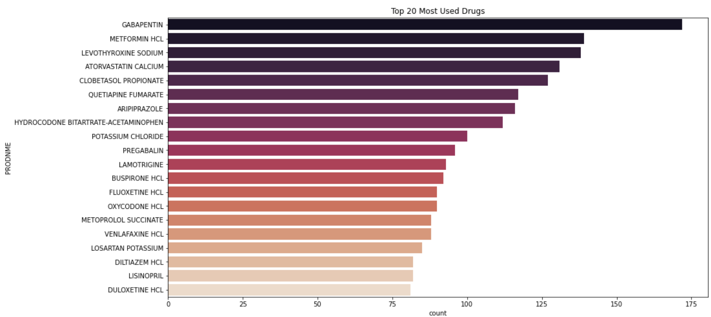
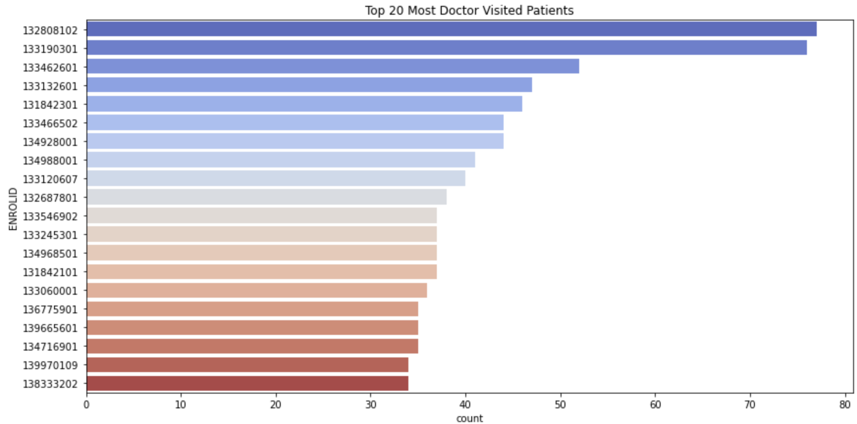
Data Exploratory
Top 20 Most Used Drugs and Doctor Visited

Slide 18
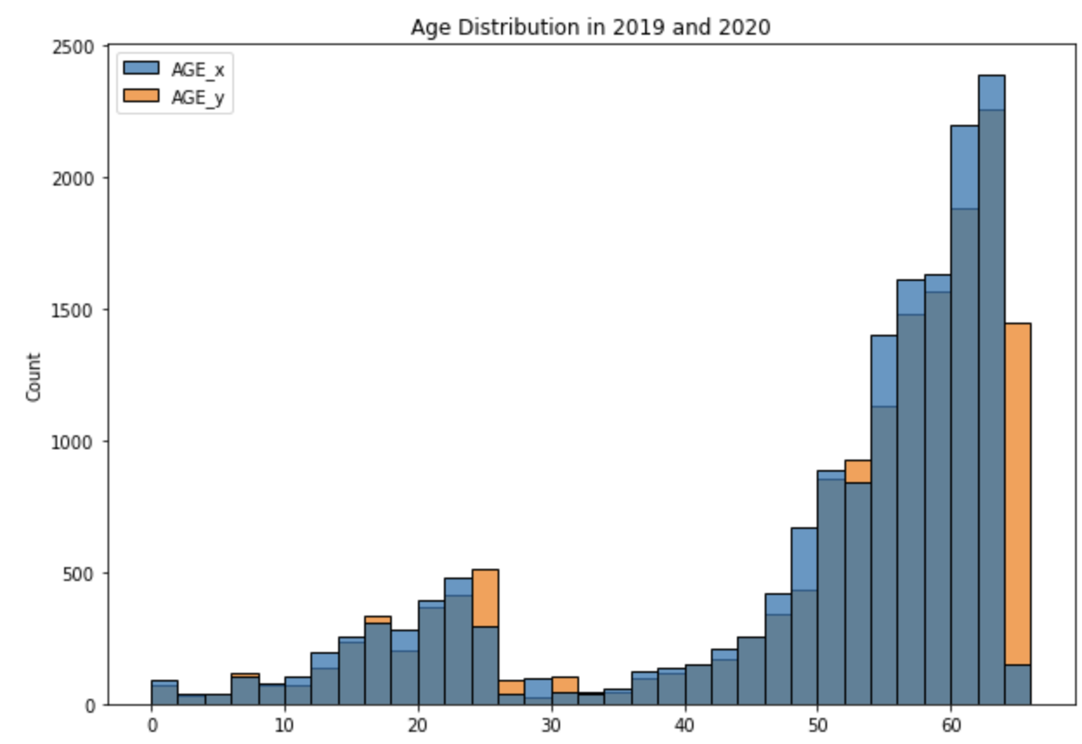
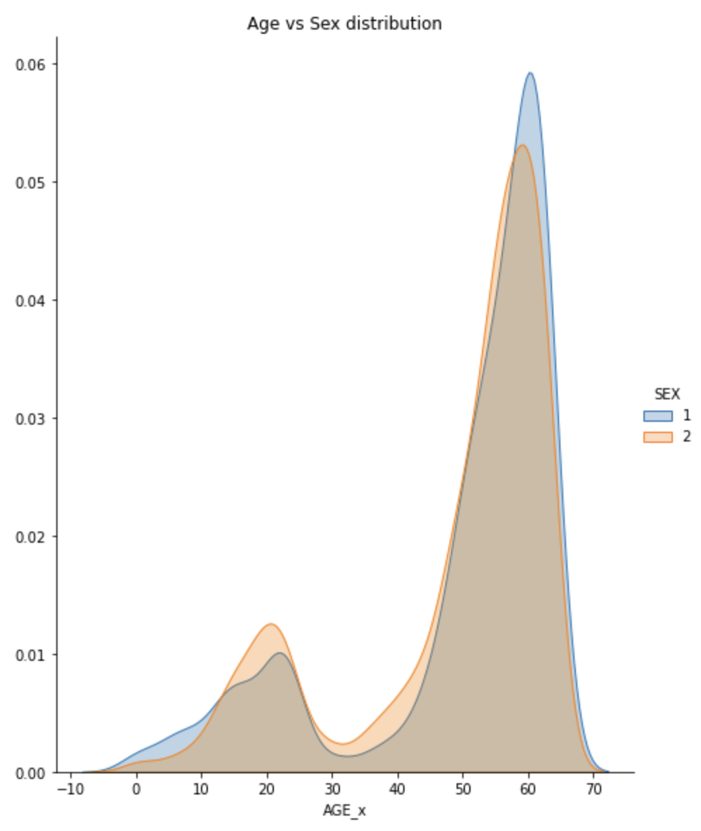
Data Exploratory
Age Distribution & Sex

Slide 19
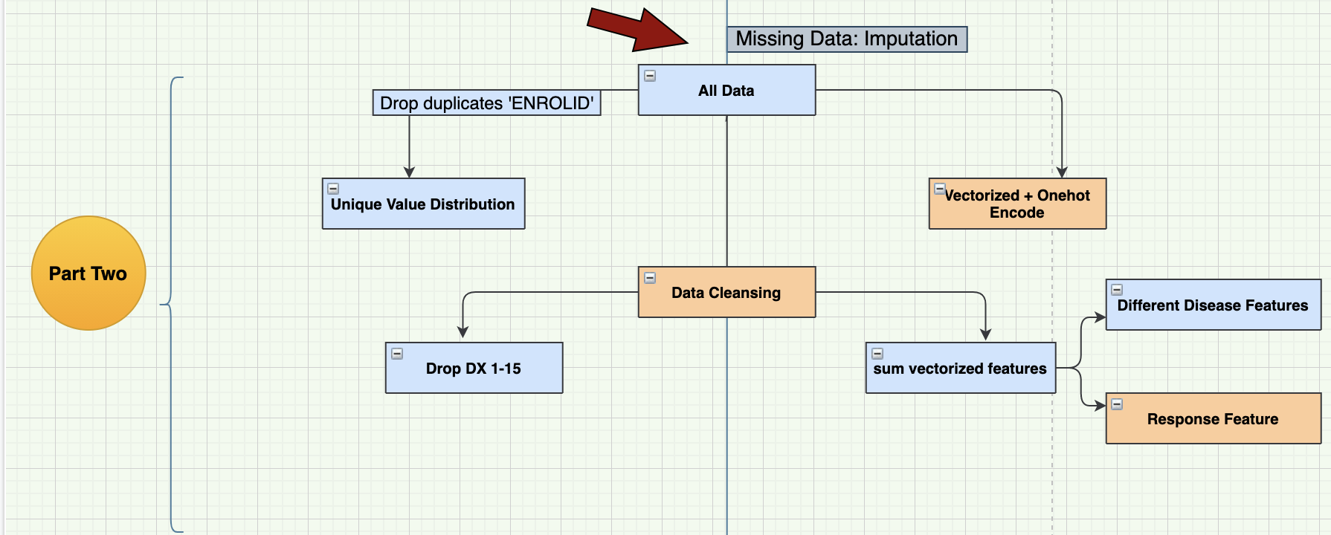
More Data Preparation

Slide 20
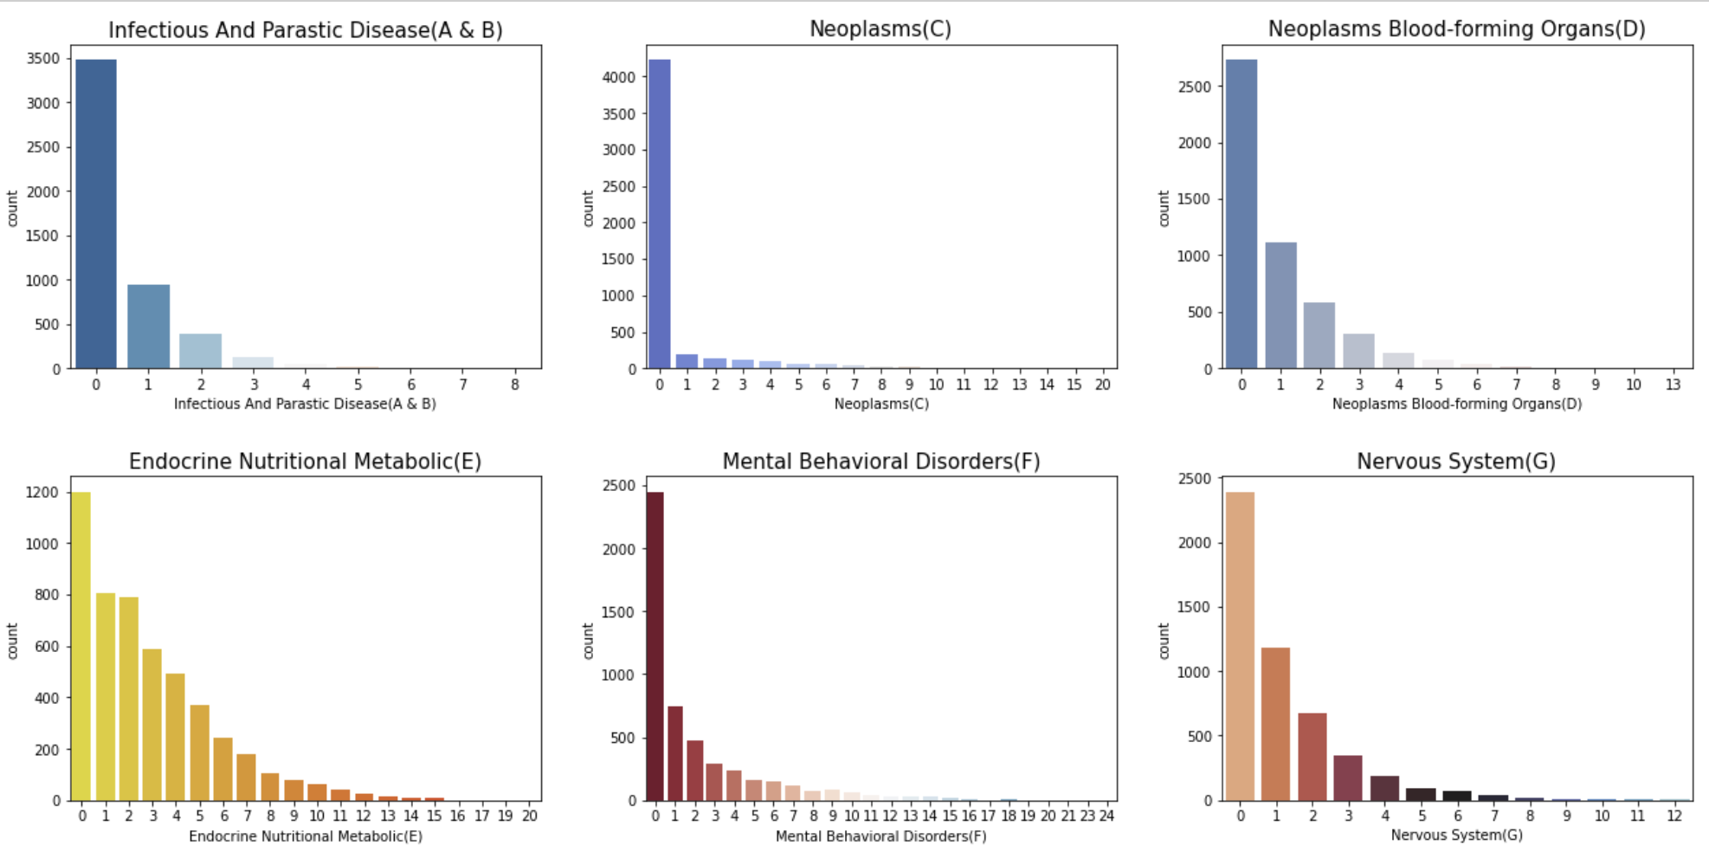
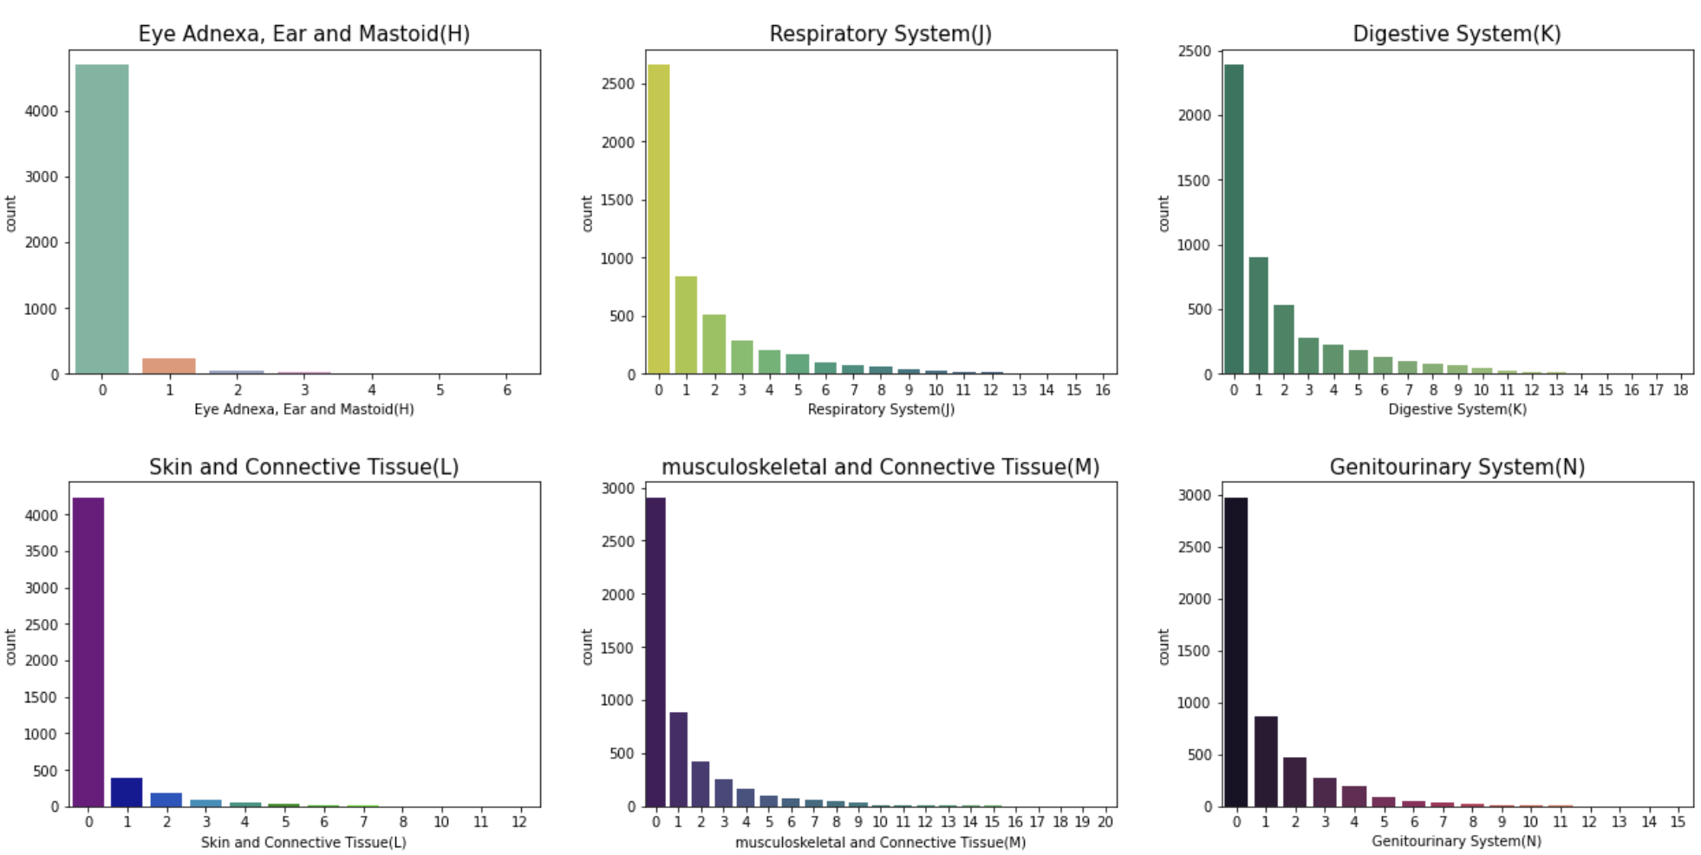
Data Exploratory
Disease Categories Distribution

Slide 21
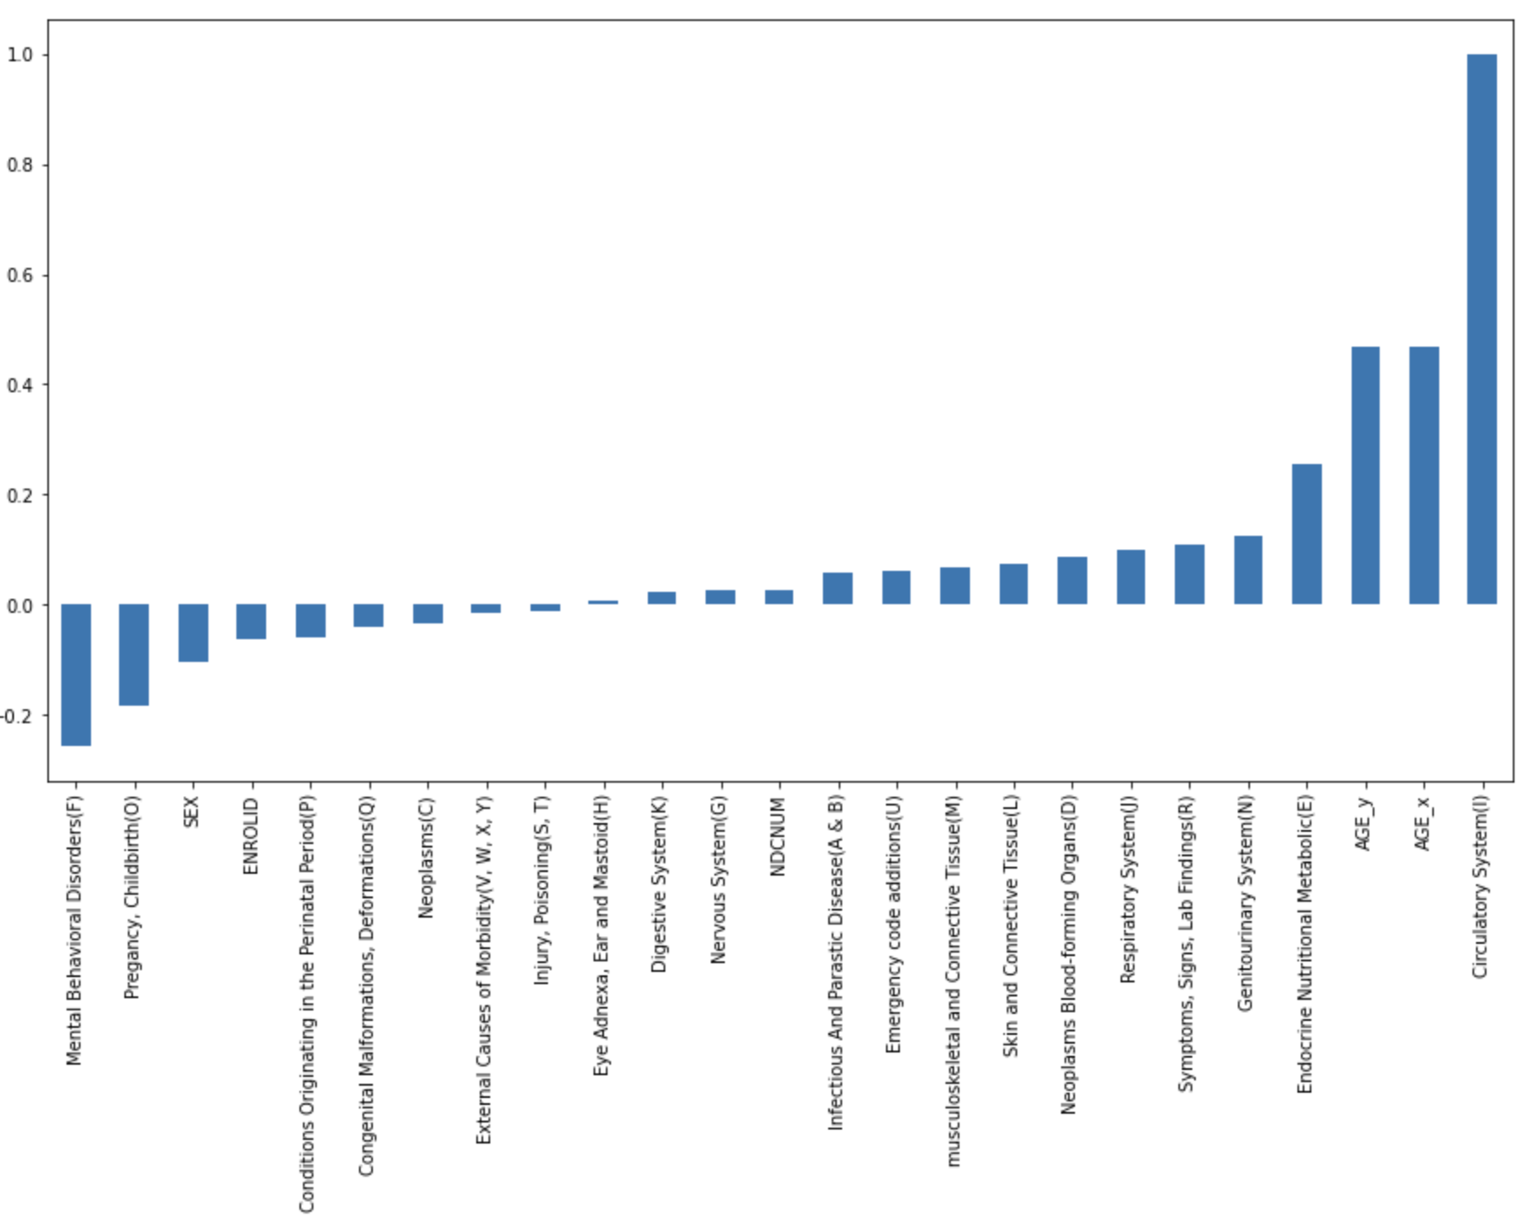
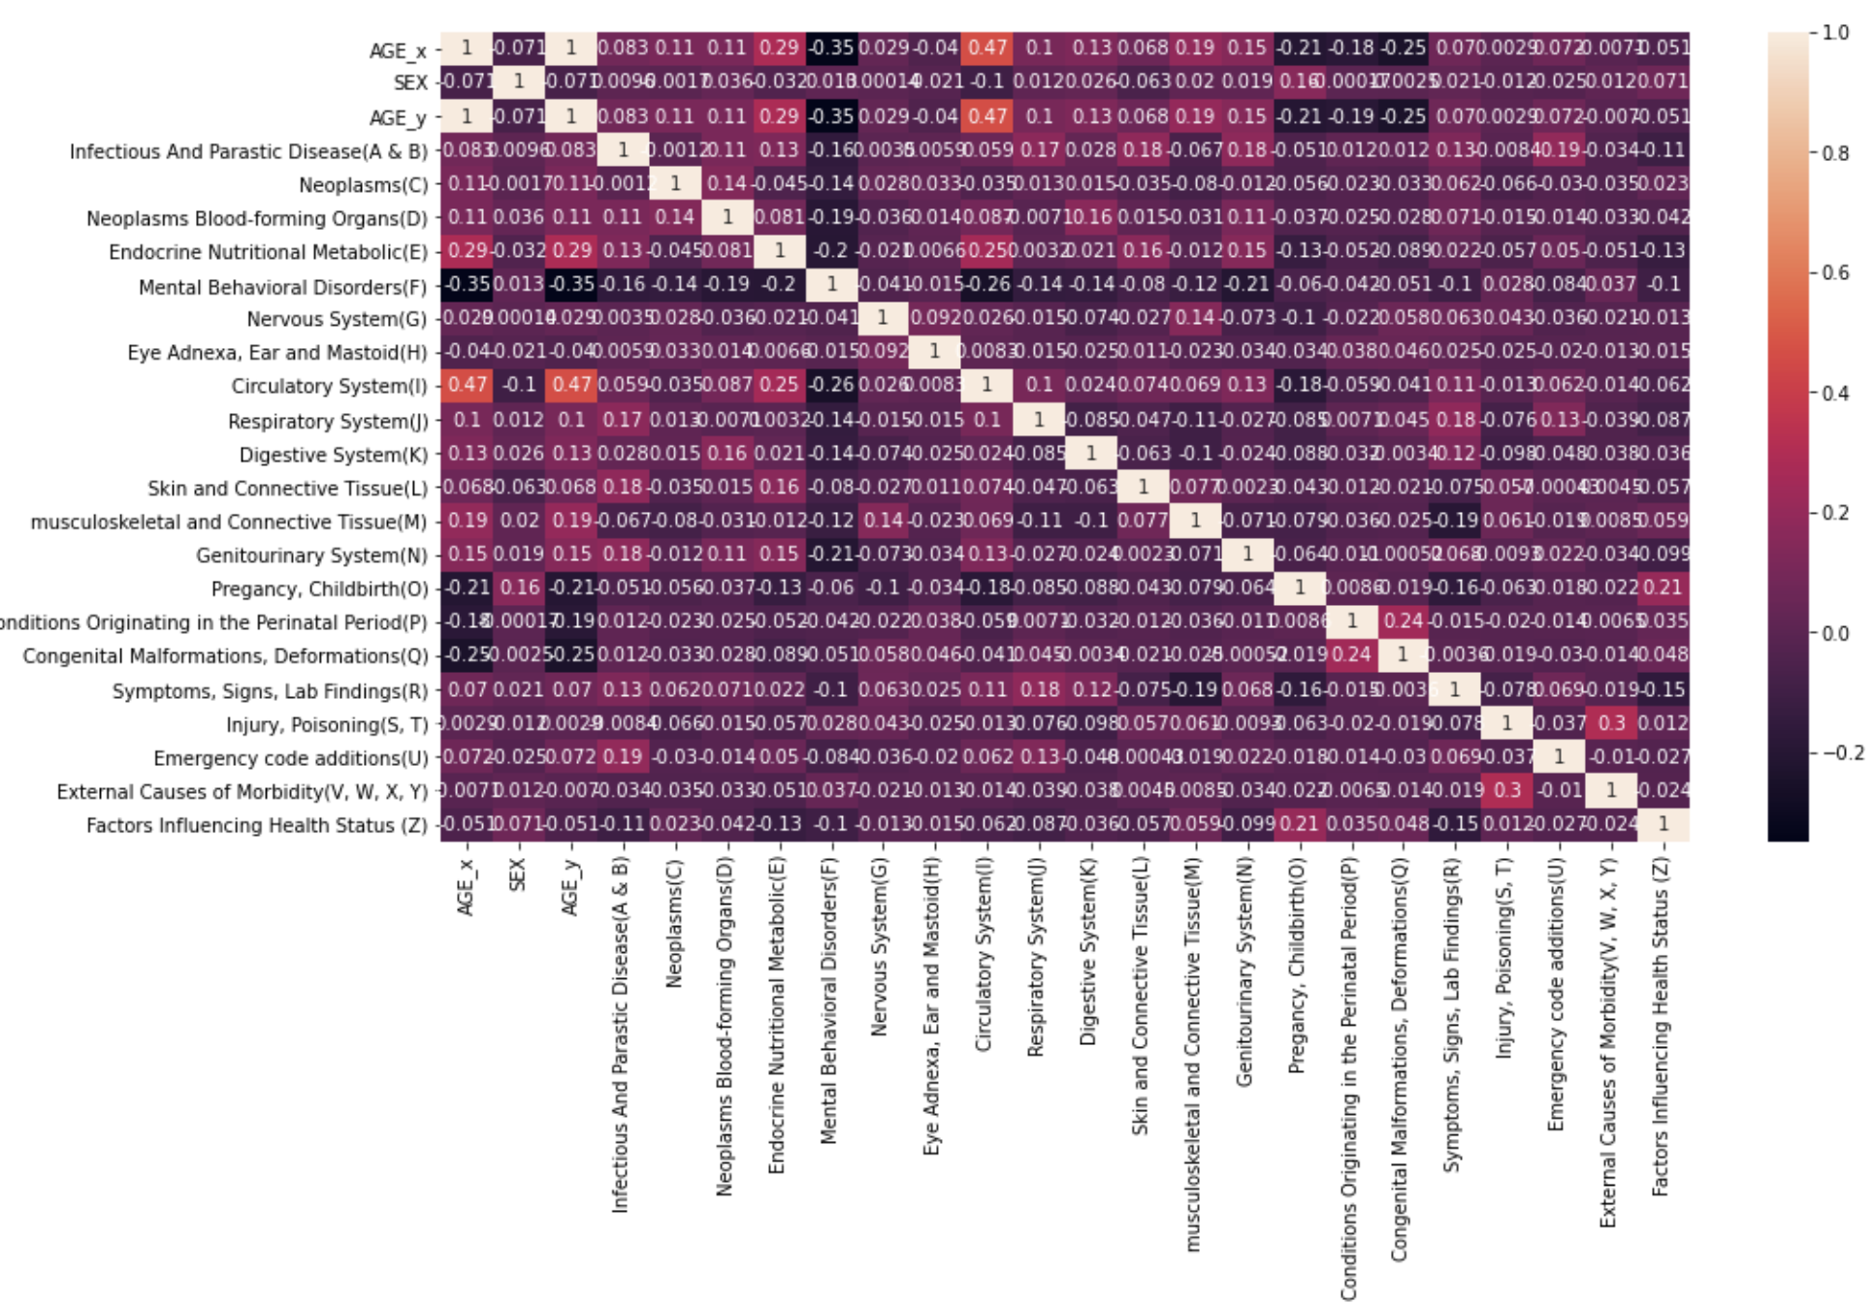
Data Exploratory
Correlation

Slide 22
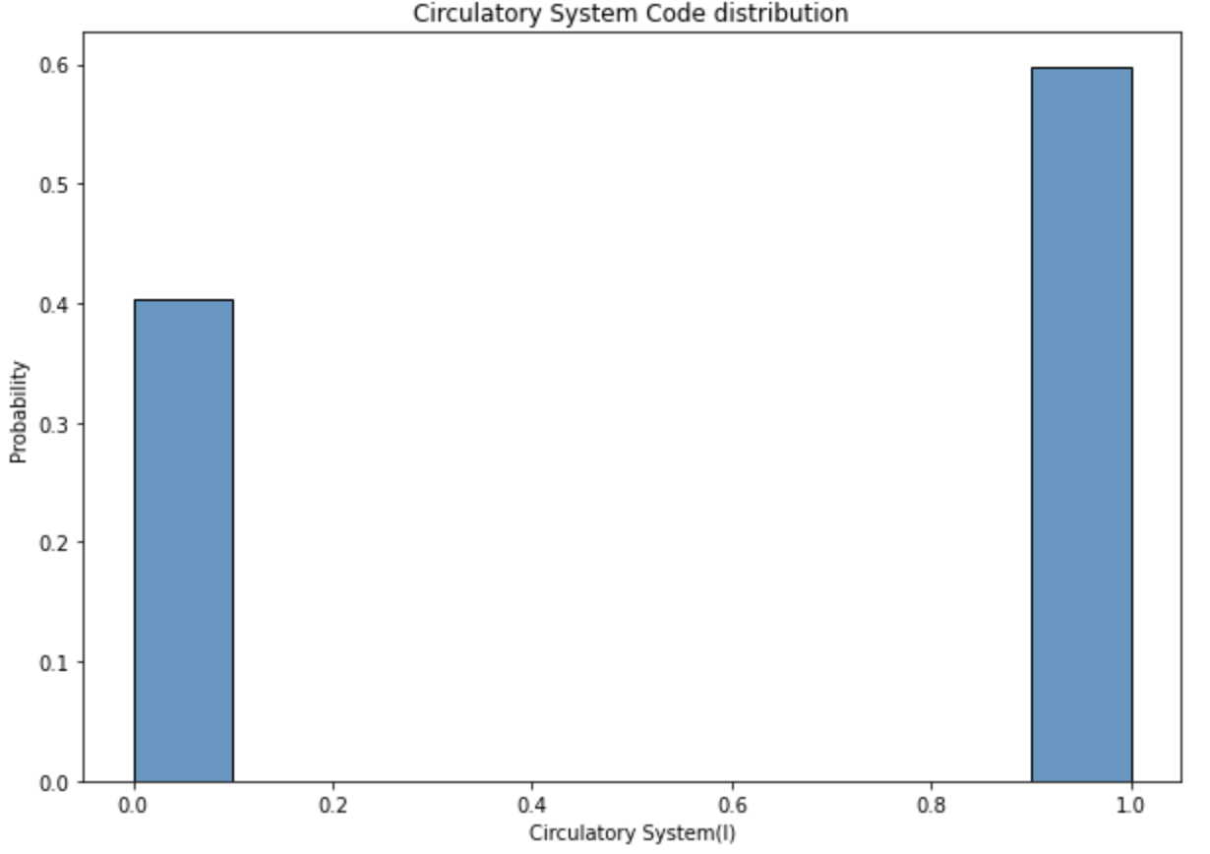
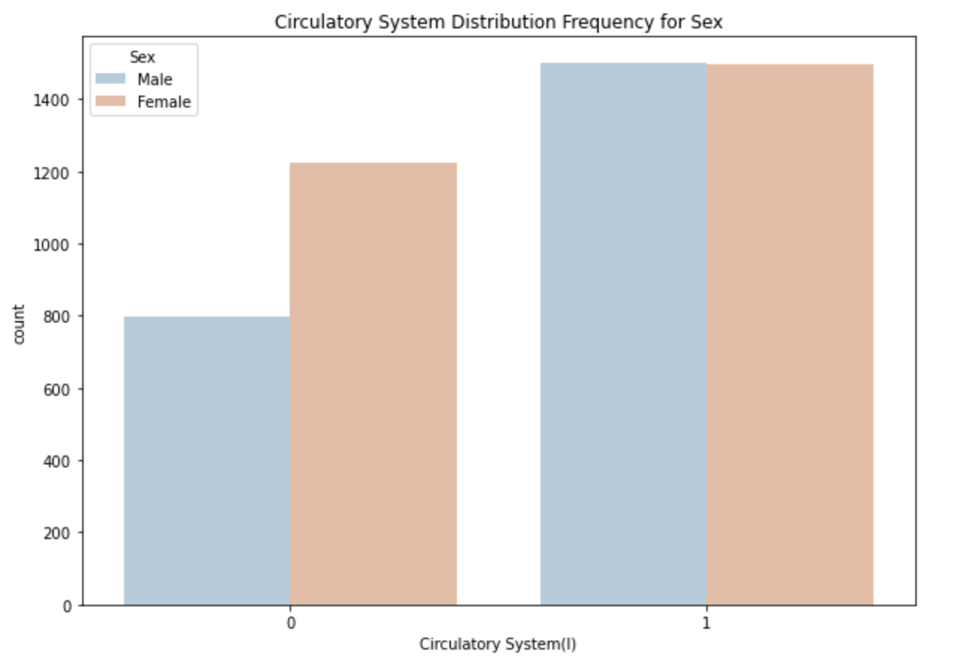
Data Exploratory
Target Variable & Sex

Slide 23
Part Three
Modeling & Evaluation

Slide 24
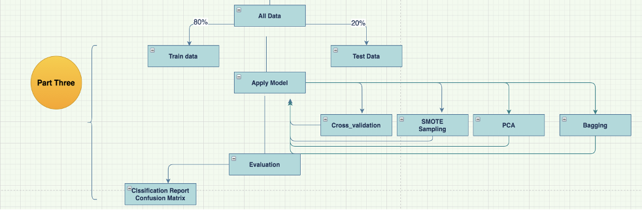
Modeling

Slide 25
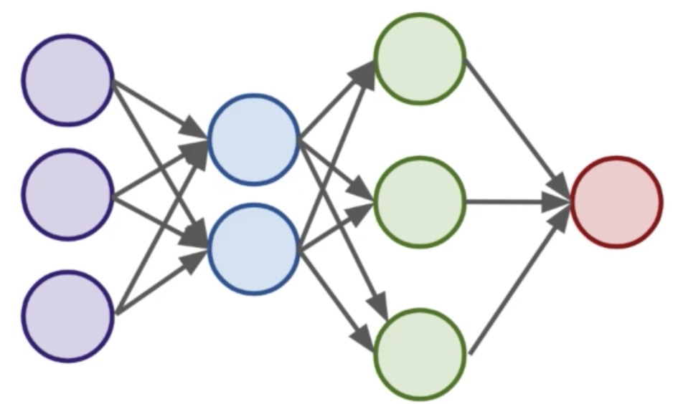
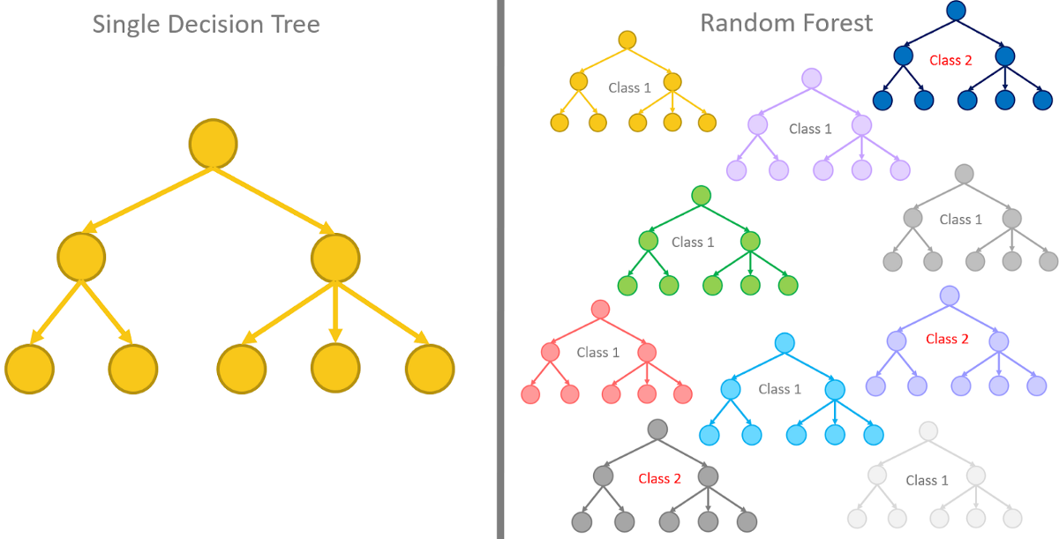
Modeling
Neural Network
Decision Tree
Random Forest
Logistic Regression

Slide 26
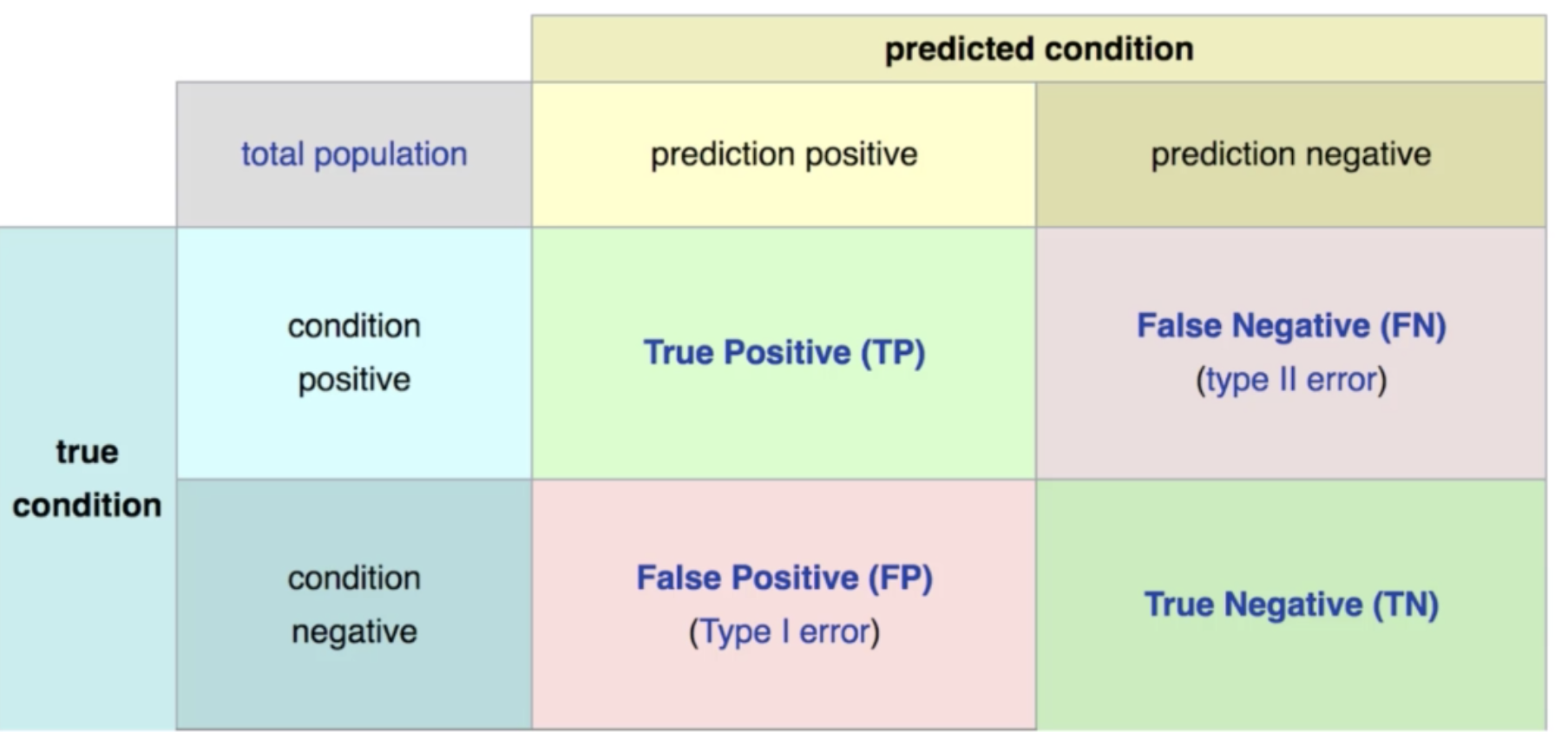
Evaluation
Area Under Curve
0.5 < AUC < 1
Distinguish the positive class values from the negative
AUC = 0.5
Not able to distinguish
F1 Score
Precision
Accurate of predicted positive
Confusion Matrix
Mainly focus on FN
Reduce False Negatives

Slide 27
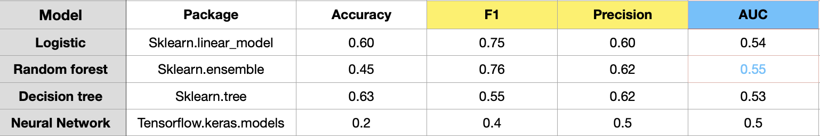
Evaluation
Results

Slide 28
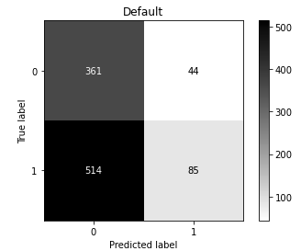
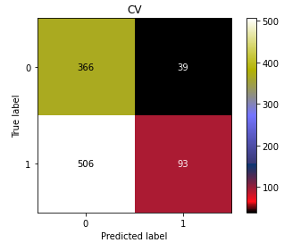
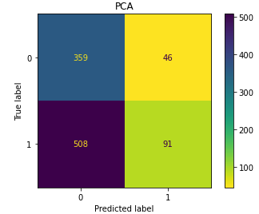
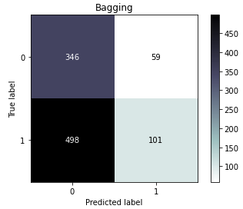
Evaluation
Confusion Matrix
Random Forest

Slide 29
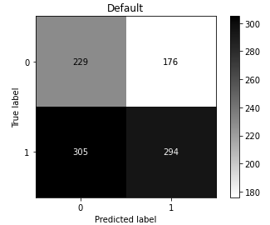
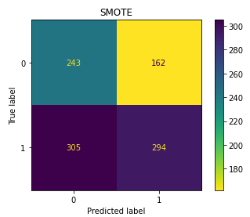
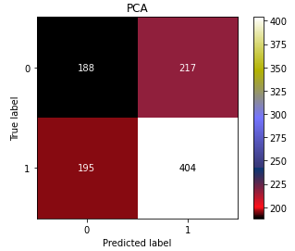
Evaluation
Confusion Matrix
Decision Tree

Slide 30
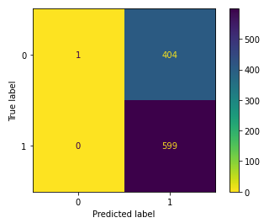
Evaluation
Confusion Matrix
Logistic Regression
Neural Network

Slide 31
Part Four
Conclusion

Slide 32
Results
The approach works, clearly distinguish the binary classes
disease -> no disease, no disease -> disease
Means whether applicants health state stable or not during the certification period
If based on one diagnosis category - heart disease
Forecasting can be done easily

Slide 33
Results
The model accuracy need to improve
Dig deeper for personal medical records info,
Weight, height, blood pressure, etc.
More personal medical records data, instead of payments, health plans

Slide 34
Future work
For this project ->
Identify personal-level clinical information with one DX - heart attack
I50.1
Procedures, Heart attack Drug took,
Personal clinical information - weight, height, Chest Pain, Heart Rate, etc.
Forecasting heart attack

Slide 35
Future work
Another Approach ->
Identify safety_critical categories relate to FAA from 21 Disease Categories
Multi-class Classification to predict the categories
Comparing critical disease categories
The likelihood from current state to a different state

Slide 36
Thank You!

Slide 38
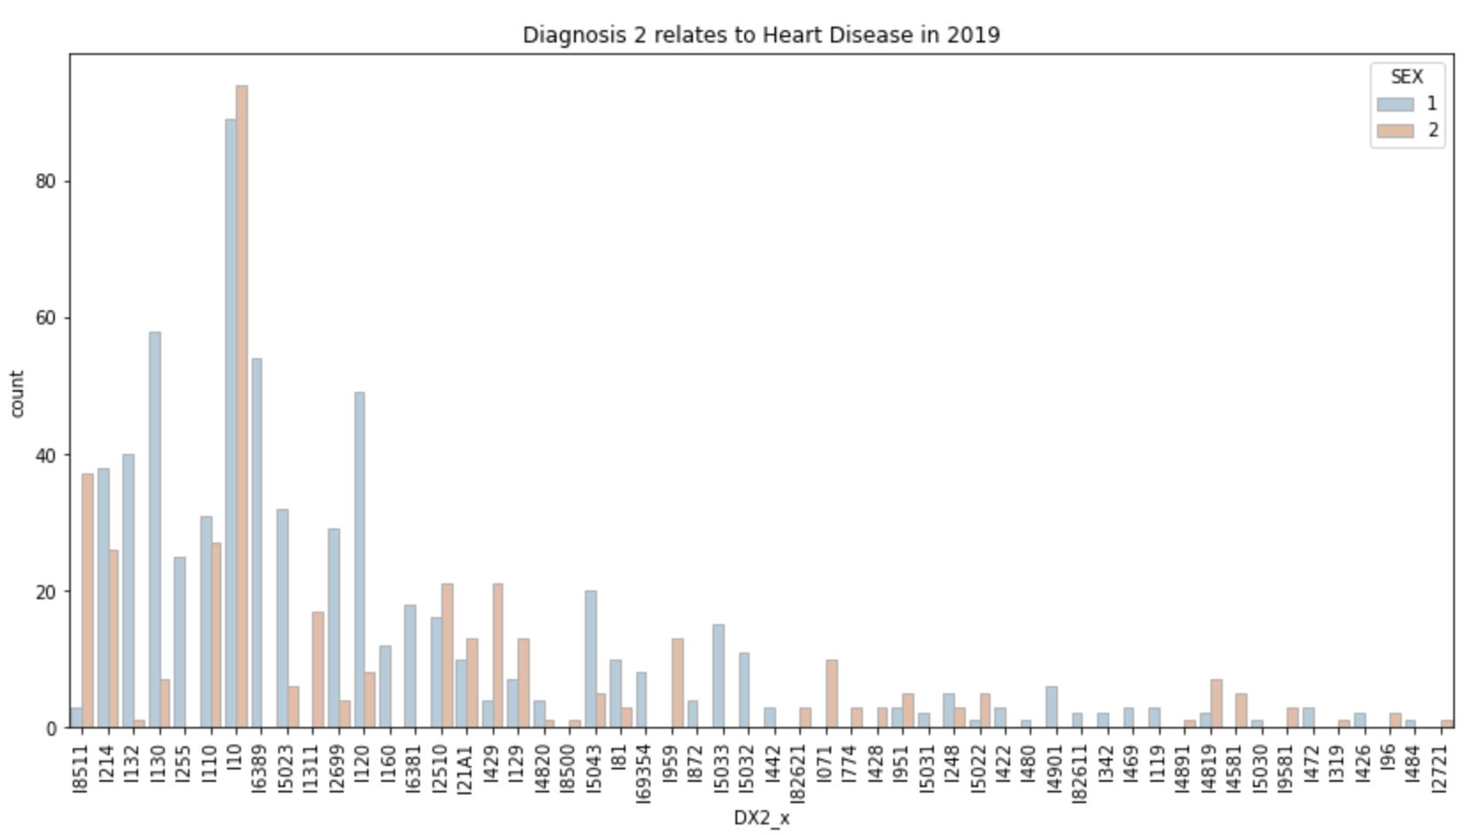
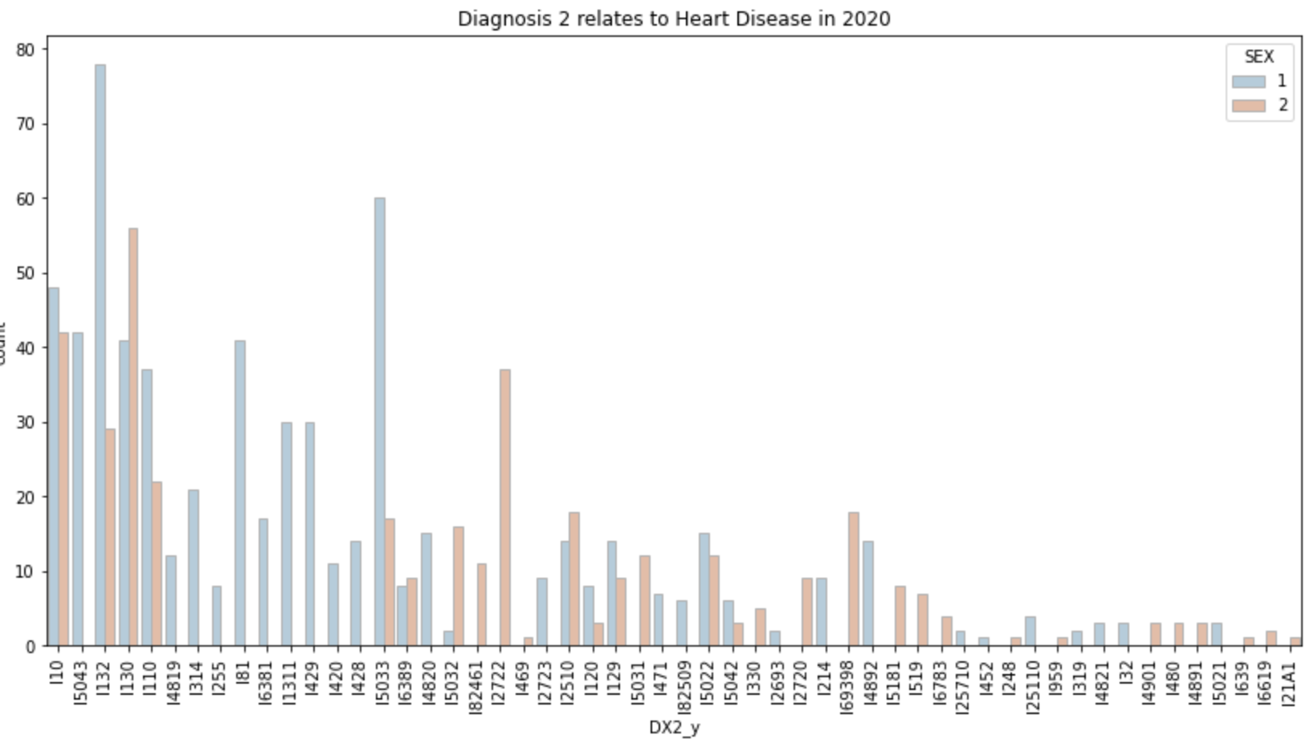
Data Exploratory
Heart Disease Diagnosis Code
2019
2020

Slide 39
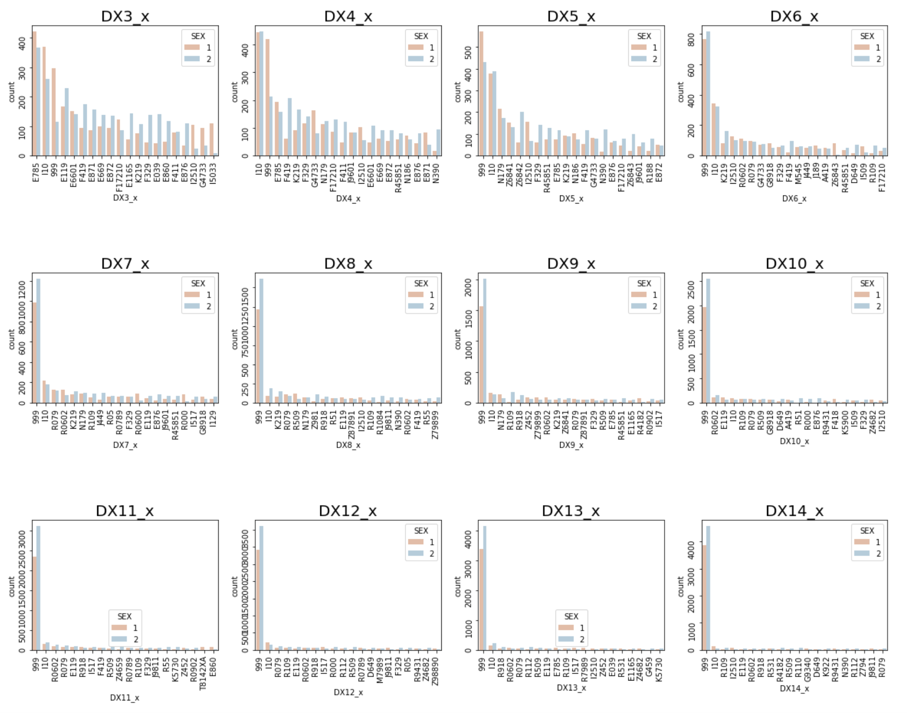
Data Exploratory
Other Diagnosis Codes
Notice the Code I10

Slide 40
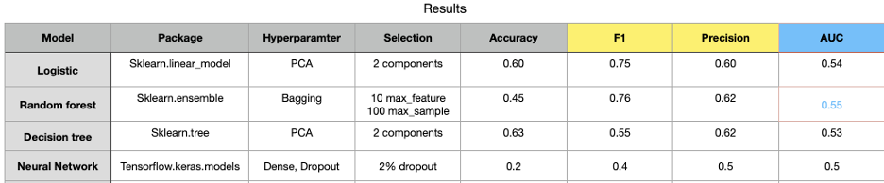
Evaluation
Results

